Slide 1
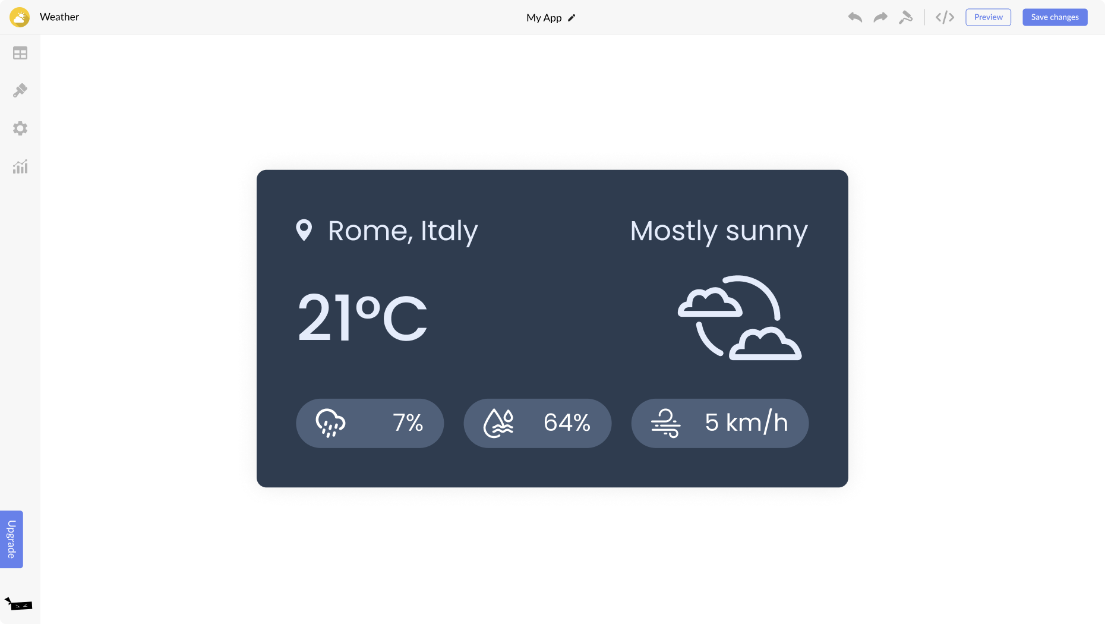
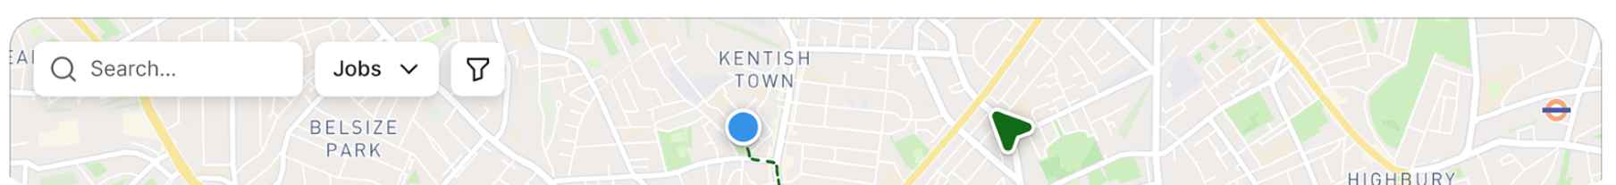
Health
Health
<Logo>
Donations
Events
Events
Safe Docs
Amenities
Donations
Finances
Finances
PTV
Safe Docs
Job Board
Reimagine A New World
Explore the essentials
Map
Safe Spaces
Laundry Services
Medical Services

Slide 2


<Logo>
Welcome!
Call 000
Amenities
Donations
Events
PTV
Health
Banking/Financial services
Safe Docs
Job Board/Skill Development Program
Service #9
Service #10

Slide 3

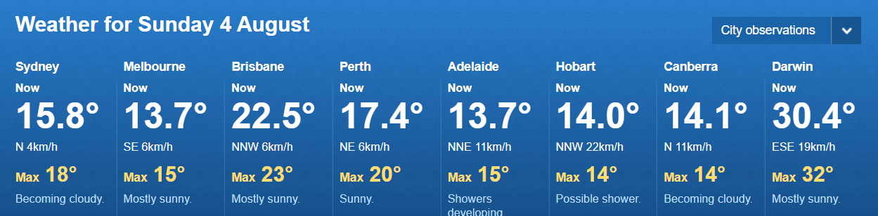
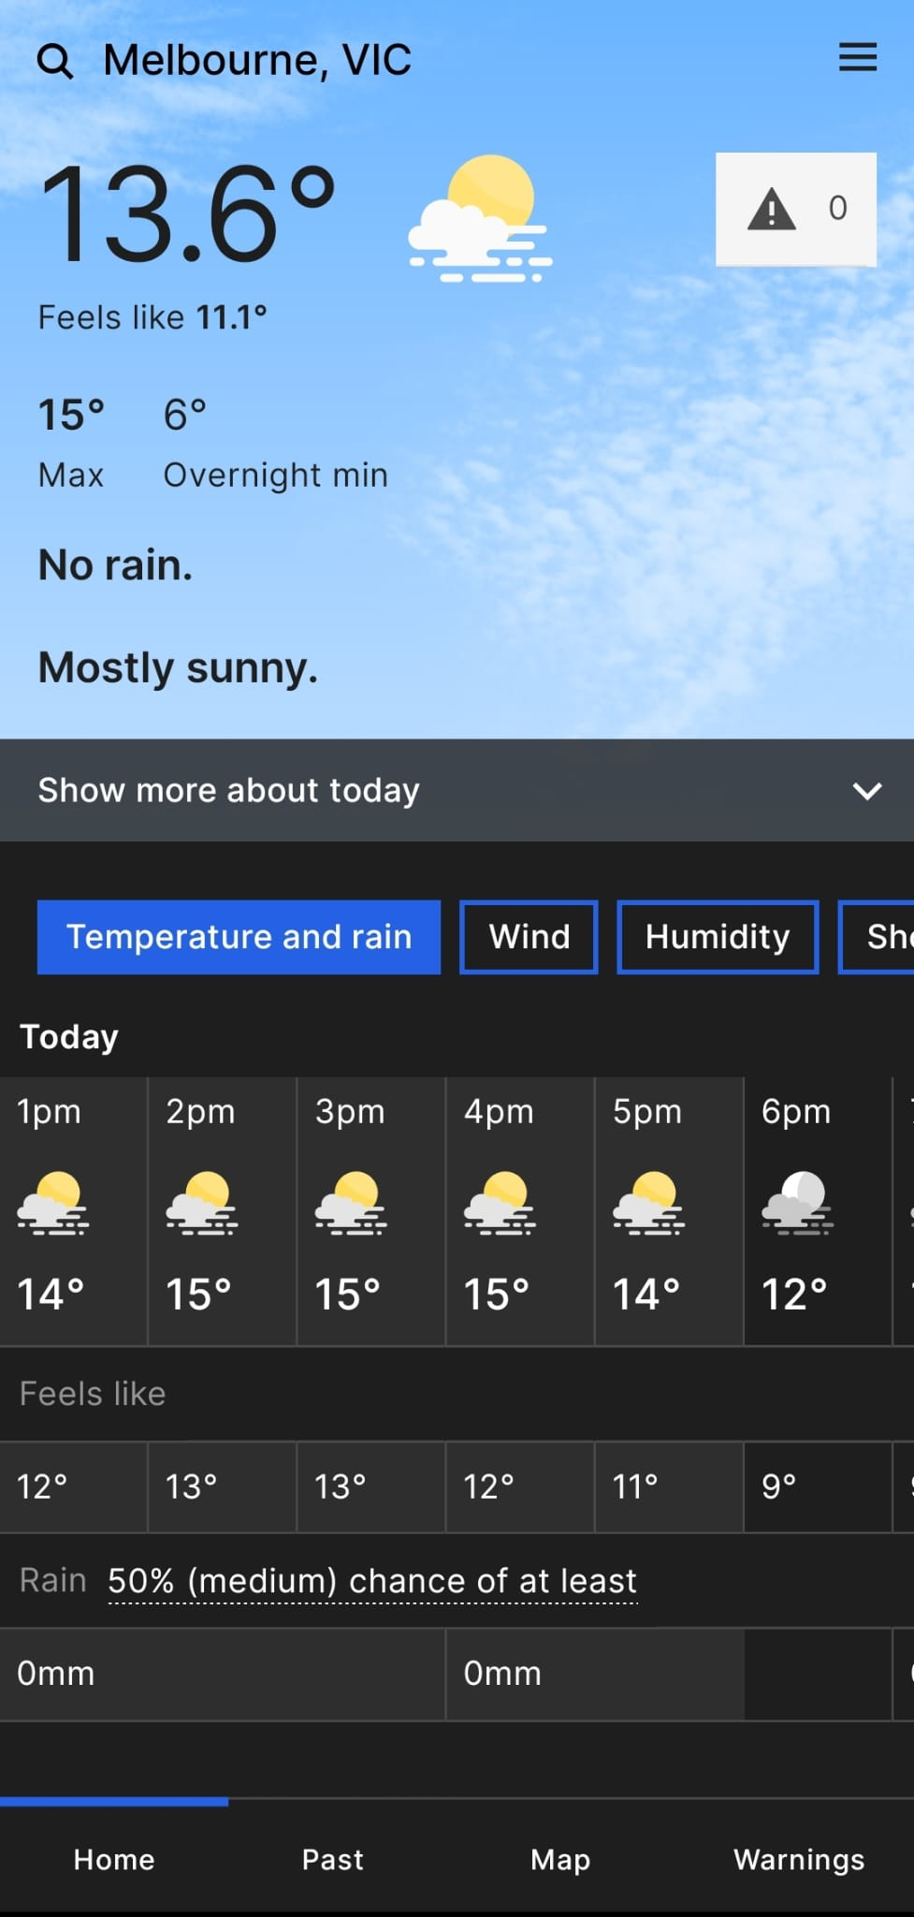
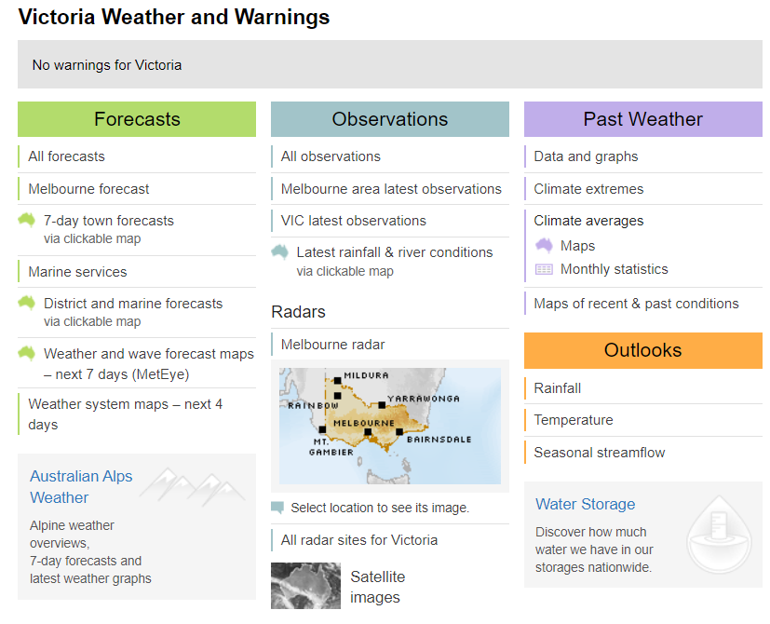
Health
Health
HOME
<Logo>
Donations
Events
Events
Safe Docs
Amenities
Donations
Finances
Finances
PTV
Safe Docs
Job Board
Weather

Slide 4
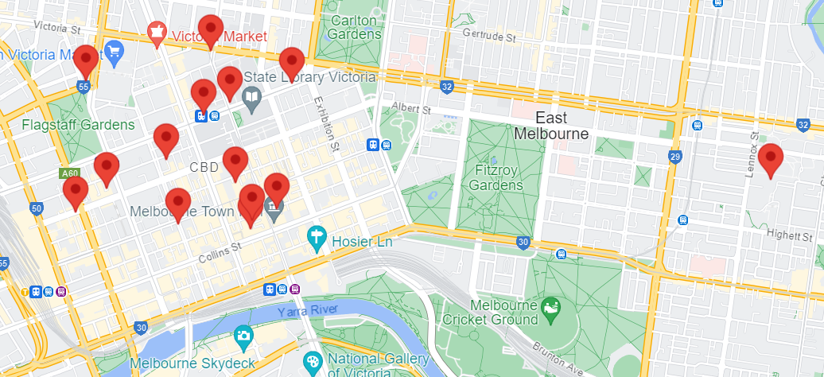

<Logo>
Amenities
Donations
Events
PTV
Health
Finances
Safe Docs
Job Board
HOME
Amenities
Find free resources near you
Search resources...
Water Taps
Public Toilets
Safe Spaces
Food Bank
First Aid
Laundry Service
Safe Injection Rooms

Slide 5
<Logo>
Amenities
Donations
Events
PTV
Health
Finances
Safe Docs
Job Board
HOME
Donations
This is a page where you can donate and find donated clothes near you
Search item (Jackets, shoes, t-shirts...)
Donate Now
Find Clothes

Slide 6
<Logo>
Amenities
Donations
Events
PTV
Health
Finances
Safe Docs
Job Board
HOME
Donate Now
Search your address to find the nearest donation point
Search your address...
Nearest Donation Points
Charity A: Address | Charity B: Address | Charity C: Address

Slide 7
<Logo>
Amenities
Donations
Events
PTV
Health
Finances
Safe Docs
Job Board
HOME
Find Items
Search items you are looking for
Search items...
Nearest Collection Points
Charity A: Address | Charity B: Address | Charity C: Address

Slide 8
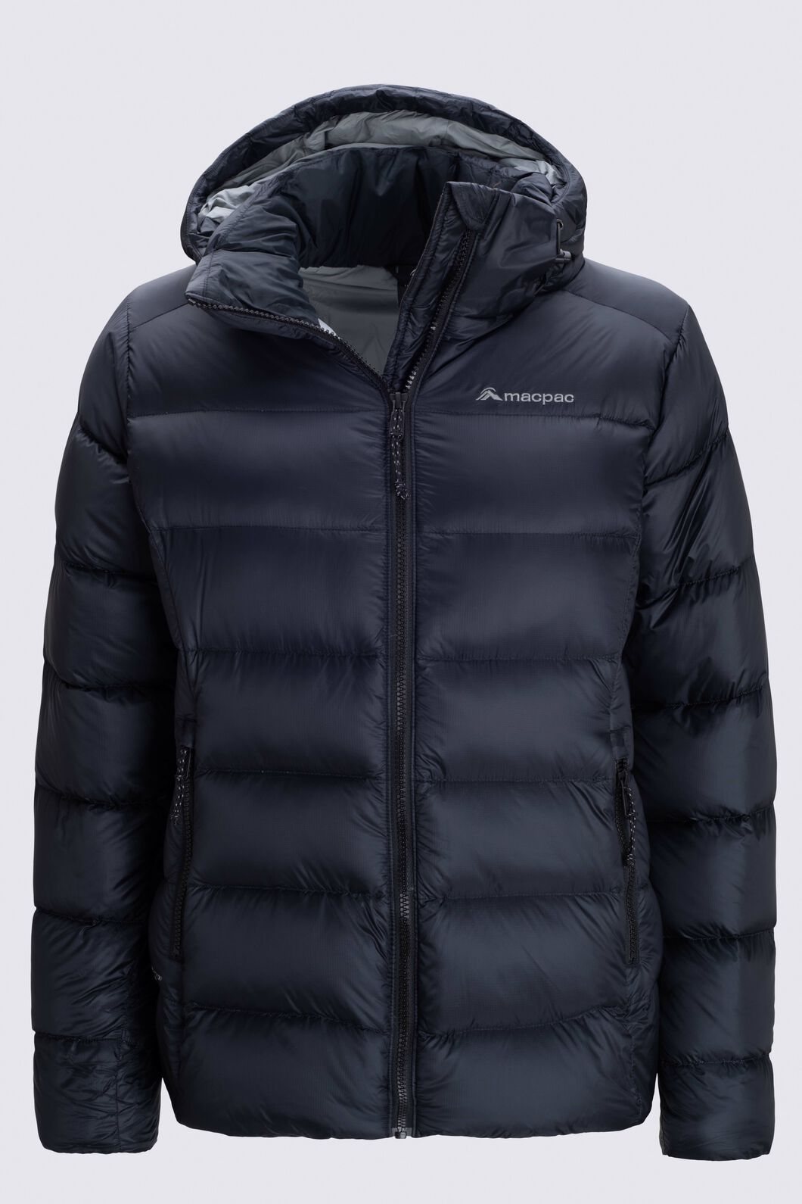
<Logo>
Amenities
Donations
Events
PTV
Health
Finances
Safe Docs
Job Board
HOME
Find Items
Search other items...
'Jacket' available closest to you
Available Closest At: "Address of collection point"
Sizes Available: S/M/L/XL/XXL
Quantity Available: "Quantity"
Other Items available at this collection point: Shirts, Socks, Boots etc.

Slide 9
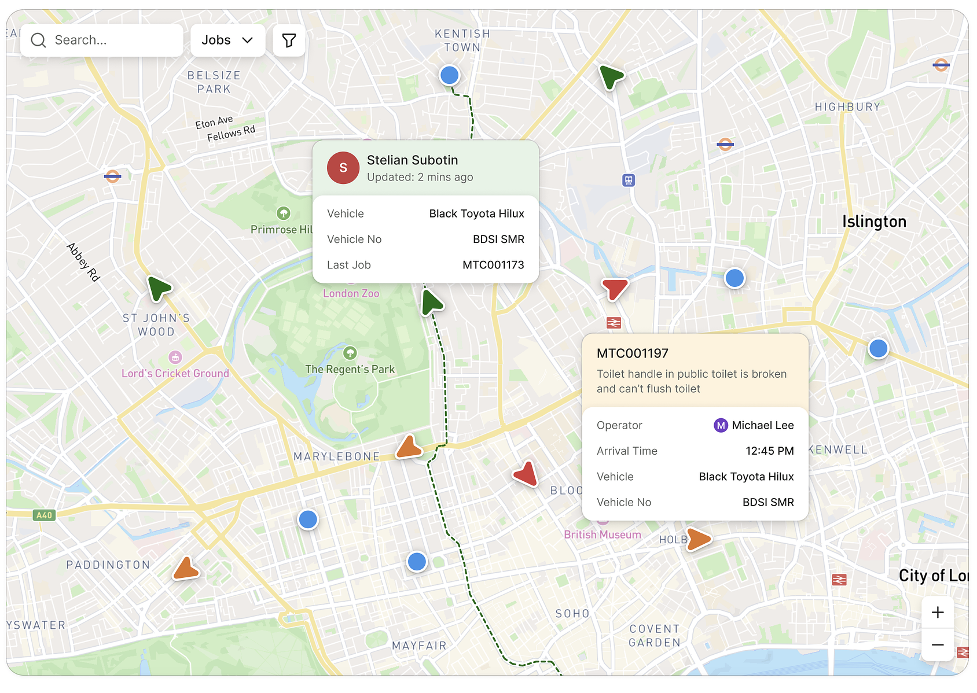
<Logo>
Amenities
Donations
Events
PTV
Health
Finances
Safe Docs
Job Board
HOME
Donations
Find the nearest Donation point
Find donation points...

Slide 10
<Logo>
Amenities
Donations
Events
PTV
Health
Finances
Safe Docs
Job Board
HOME
Donations
Find closest Pick-up Point
Search items
Items in stock at nearest Pick-up Point:
Shoes
Caps
Scarfs
Pants

Slide 11
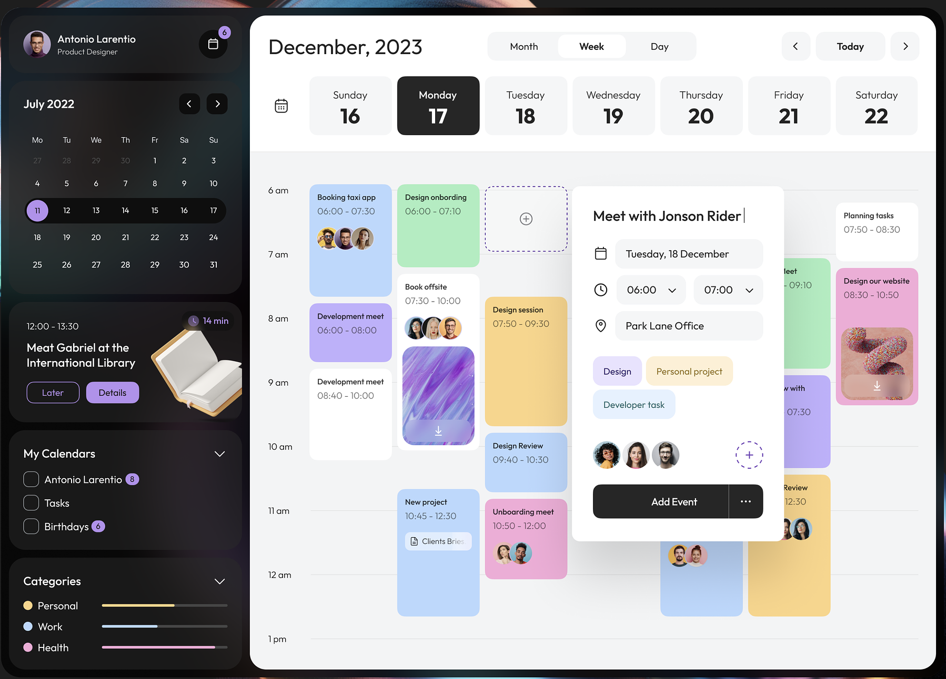
<Logo>
Amenities
Donations
Events
PTV
Health
Finances
Safe Docs
Job Board
HOME
Events

Slide 12
<Logo>
Amenities
Donations
Events
PTV
Health
Finances
Safe Docs
Job Board
HOME
Public Transport Victoria
Find all PTV info here
Find destination, stops and routes...
Journey Planner
Tram network Map
Train network Map
Myki Top Up

Slide 13
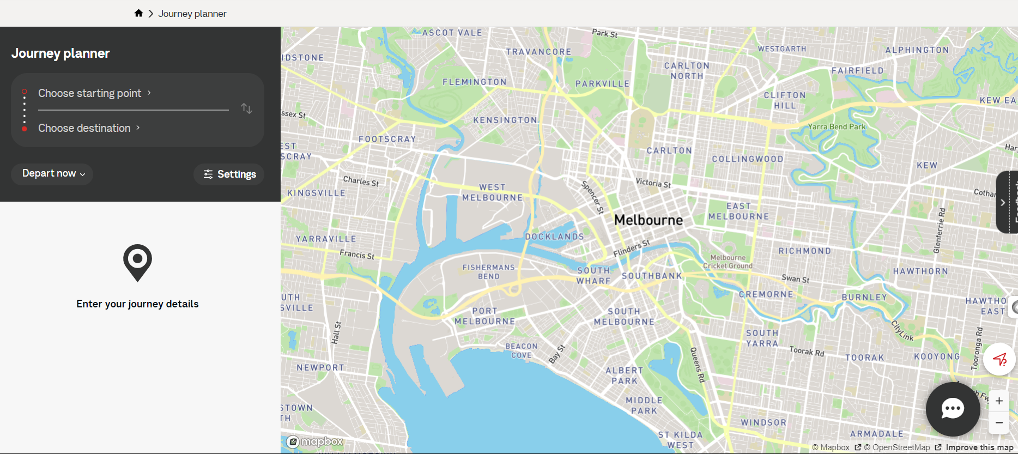
<Logo>
Amenities
Donations
Events
PTV
Health
Finances
Safe Docs
Job Board
HOME
Public Transport Victoria
Journey Planner

Slide 14
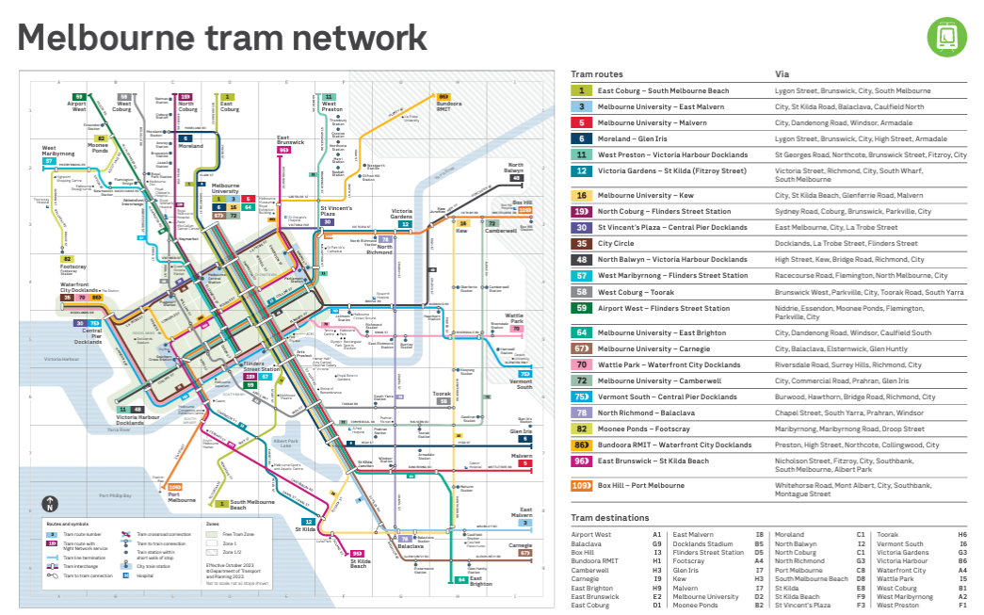
Health
Health
HOME
<Logo>
Donations
Events
Events
Safe Docs
Amenities
Donations
Finances
Finances
PTV
Safe Docs
Job Board
Public Transport Victoria

Slide 15
<Logo>
Amenities
Donations
Events
PTV
Health
Finances
Safe Docs
Job Board
HOME
Health
Medical Advice for Adults
Search your symptoms
Covid-19
Conditions
Procedures
Health Topics A-Z​

Slide 16
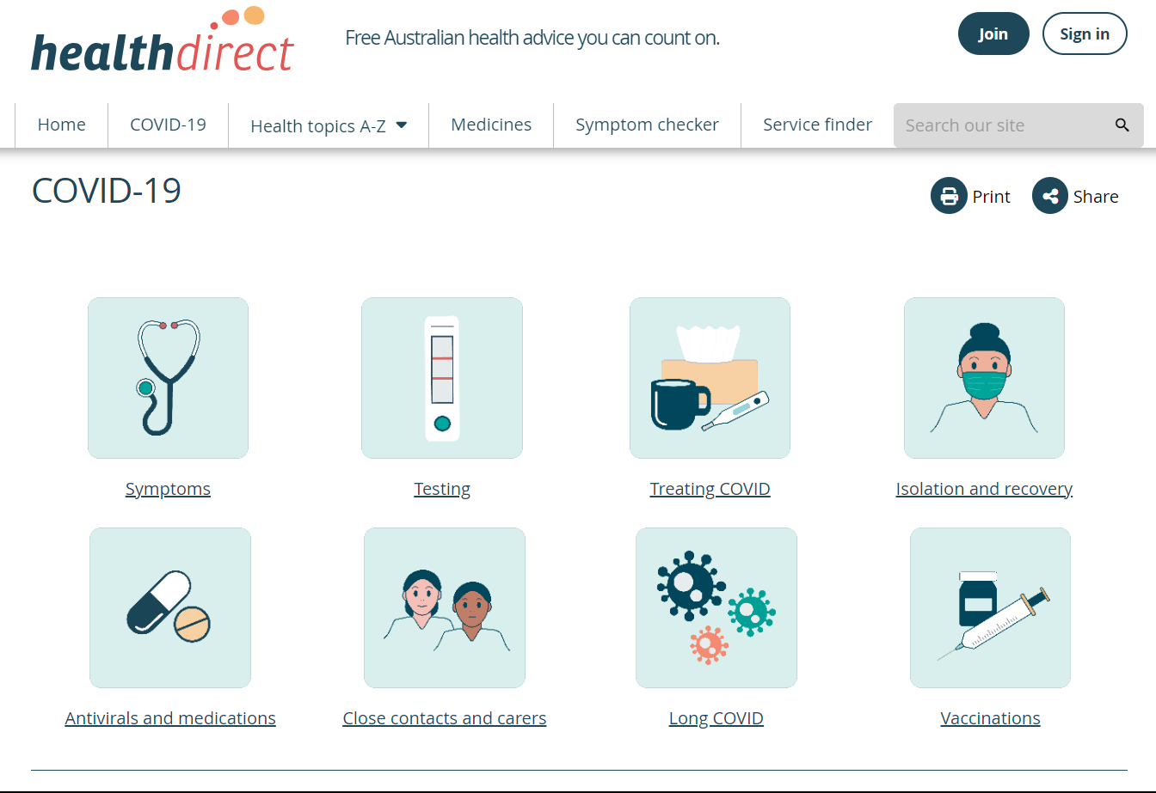
<Logo>
Amenities
Donations
Events
PTV
Health
Finances
Safe Docs
Job Board
HOME
Search your symptoms
Health
Covid-19

Slide 17

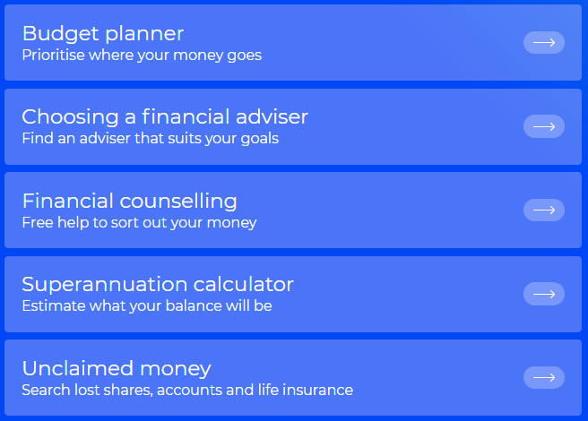
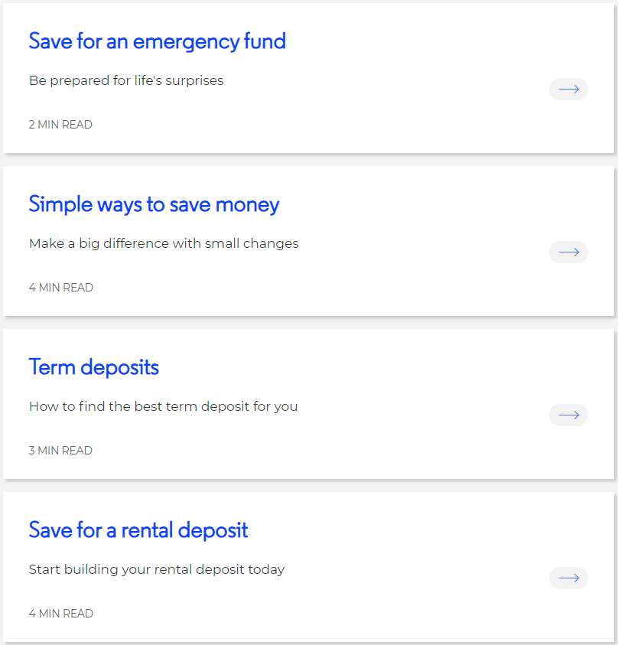
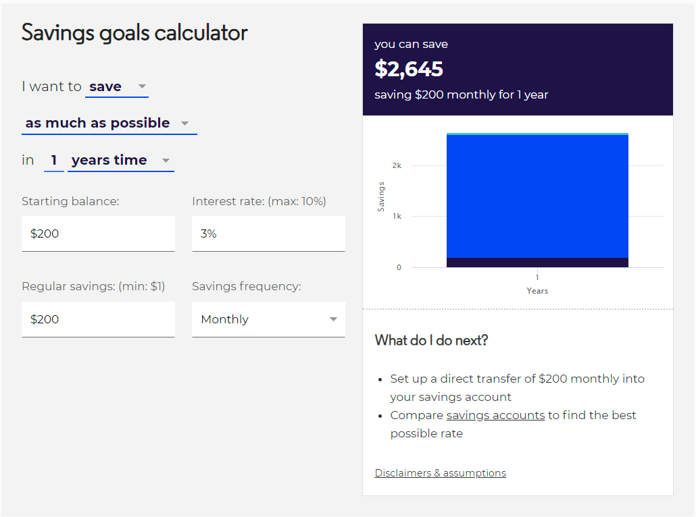
​
<Logo>
Amenities
Donations
Events
PTV
Health
Finances
Safe Docs
Job Board
Finances
ABOUT US
CONTACT US
​
GLOSSARY
MEDIA CENTRE

Slide 18


Amenities
Donations
Events
PTV
Health
Finances
Safe Docs
Job Board
Safe Docs
Username:
Enter Username
Password:
Enter Password

Slide 19
<Logo>
Amenities
Donations
Events
PTV
Health
Finances
Safe Docs
Job Board
Safe Docs
A place to store and access all your legal identification documents
Sign in to Google Drive/Dropbox /One Drive
Upload Now
My Files

Slide 20

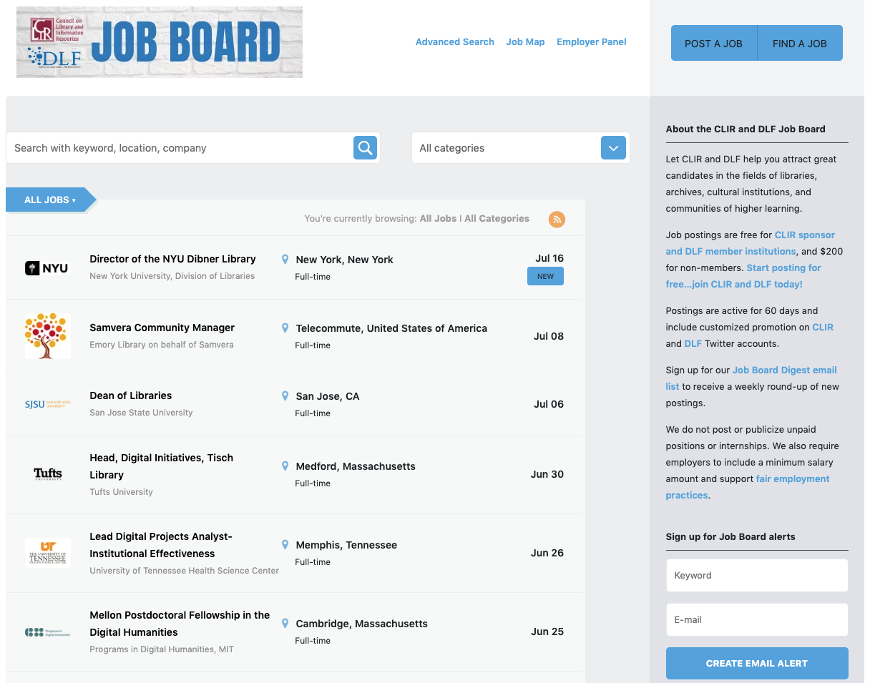
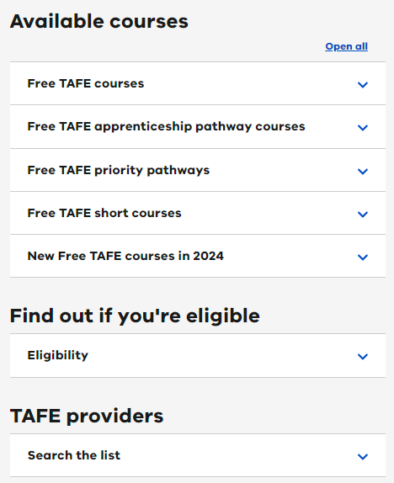
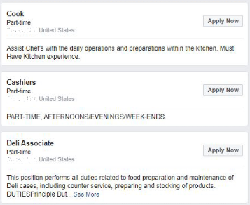
<Logo>
Amenities
Donations
Events
PTV
Health
Finances
Safe Docs
Job Board
Job Board

